Slide 1

Sri Eshwar College of Engineering
(An Autonomous Institution – Affiliated to Anna University)
COIMBATORE – 641 202
U23AD481 - PYTHON FOR AI
PROJECT WORK
Present by
Enoch Jason J
722824148024
AIML-A
Date : 02.06.2025
Spam Email Detection

Slide 2

Outline
This project focuses on the implementation and importance of unit testing in modern software development.
Unit testing is a method by which individual units or components of a software application are tested independently to ensure that each part functions correctly in isolation.
The main goal of this project is to demonstrate how unit tests improve software reliability, maintainability, and bug detection during development.

Slide 3
Objective
The objective of this project is to develop an interactive web-based platform that enables users to easily test and analyze Python code.
Designed with a user-friendly interface, the platform allows users to either upload Python files or paste their code directly into the application.
Once submitted, the code undergoes a testing process, where it is executed and analyzed to generate meaningful feedback or results.

Slide 4
Introduction
The system aims to streamline the debugging and validation process for developers, especially those who want quick insights into their code’s behavior without setting up a local testing environment.
By integrating components like file upload, code input, automated testing, and result analysis, the project provides a comprehensive tool for code validation, making it especially useful for educational purposes, coding practice, and quick prototype verification

Slide 5
Existing Solution
Ponicode – AI-powered unit test automation, available as a Visual Studio Code extension.
Diffblue – Uses AI models to automate unit tests and integrates with mocking frameworks
.
Symflower – Focuses on security and performance issues while automating unit tests.
Parasoft – Supports multiple compilers and automates unit testing.
Tricentis – Provides end-to-end test automation.

Slide 6
Literature survey
S.NO | RESEARCH PAPER | Year | AUTHOR | OBSERVATION
1 | Automated Unit Test Case Generation: A Systematic Literature Review | 2025 | Authors: Jason Wang, Basem Suleiman | This paper identifies gaps in evolutionary algorithms like Genetic Algorithms and Particle Swarm Optimization for automated unit testing. It highlights improvements such as hybrid algorithm combinations and integration with mutation testing and neural networks
2 | Automatic Unit Test Generation for Machine Learning Libraries: How Far Are We?" | 2021 | Authors: Song Wang, Nishtha Shrestha, Junjie Wang, | The study finds that existing unit test generation tools improve code coverage but have limitations when applied to machine learning libraries. It suggests common patterns in uncovered code that could enhance future test generation techniques
3 | Statistical Twitter Spam Detection Demystified | 2021 | Authors: Prajwal Wable, Mangesh Kumar | This paper proposes a machine learning-based approach to generate unit test cases by learning from developer-written tests. It aims to improve efficiency and readability compared to traditional synthetic test case generation methods

Slide 7
Problem Statement
In many coding environments, especially for beginners or those working on quick prototypes, setting up a local development and testing environment can be time-consuming, complex, and prone to errors.
Developers often face challenges in validating their code quickly due to dependencies, system configurations, or lack of testing tools.
Additionally, educational settings or coding workshops require a simplified way for learners to test and understand their code without the hassle of full software installations.

Slide 8
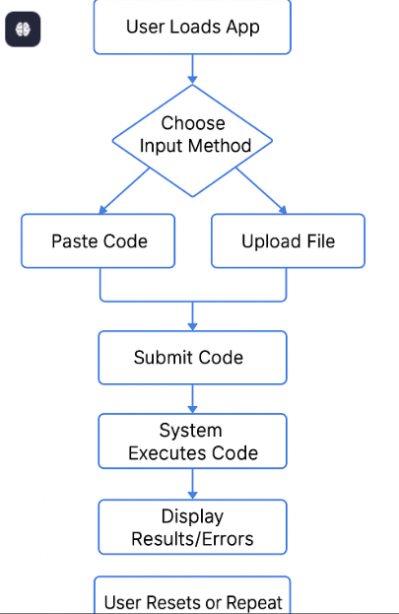
Proposed Work – Block Diagram

Slide 9
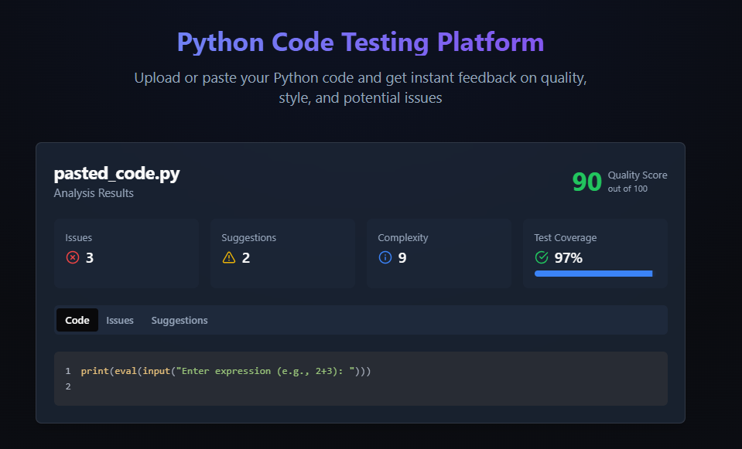
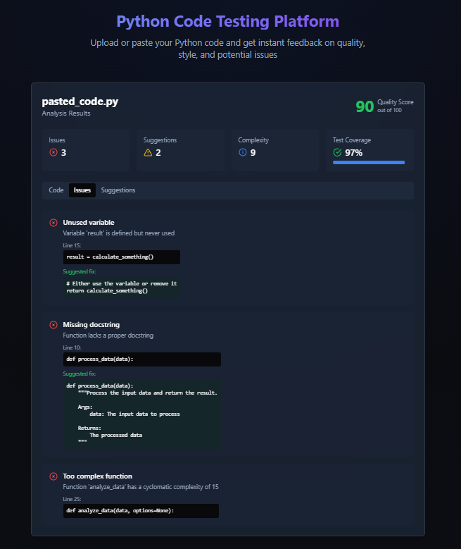
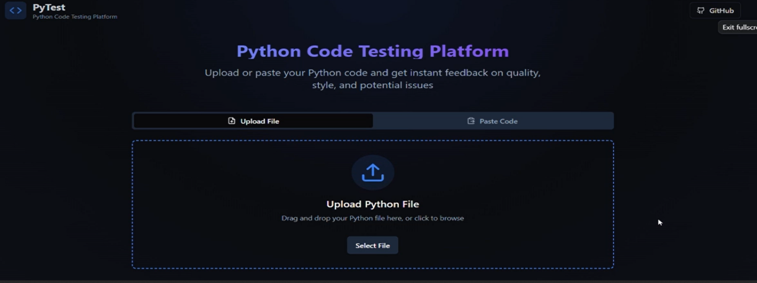
Output

Slide 10
Conclusion
This project serves as a foundational platform for automating code analysis and initiating unit testing workflows. It enables users to input or upload code, perform basic analysis like line counts and function detection, and simulate test runs — all through a clean, user-friendly interface. While currently lightweight, this solution demonstrates a strong potential to scale into a full-fledged code quality management tool for developers, students, and teams..
Future Work
Future Enhancements
1. Peer Code Review System
2. Real Unit Testing Integration
3. Code Quality Metrics
4. Code Versioning and History
5. Authentication and Role Management
6. Collaboration & Sharing
.

Slide 11
Reference
1. Django Software Foundation. Django Documentation. Retrieved from https://docs.djangoproject.com/en/stable/
(Accessed May 20, 2025)
2. Google Chrome Developers. Chrome Extensions Documentation. Retrieved from https://developer.chrome.com/docs/extensions/mv3/
(Accessed May 20, 2025).
3. Spam Transformer Model for SMS Spam Detection by Xiaoxu Liu
https://ieeexplore.ieee.org/document/9433507
4. Machine Learning-Based Opinion Spam Detection: A Systematic Literature Review by Atika Qazi
https://ieeexplore.ieee.org/document/10528318
5. Statistical Twitter Spam Detection Demystified: Performance, Stability, and Scalability by Guanjun Lin
https://ieeexplore.ieee.org/document/7937783

Slide 12



